Slide 1
Coupling of ALFF, CBF (BASIL), and IDEMO (task) modalities
Fengling Hu
10/8/21

Slide 2
Order of content
Barplots on networks and subcortical structures
Raw data
Coupling
Descriptive images (voxel means and variance across 760 subjects)
Raw data
Coupling
Binary thresholded p-value maps (FDR 0.05)
Raw data
Coupling

Slide 3
Of note
CBF images are ISLA corrected. I’m planning on using BASIL-corrected CBF instead.
IDEMO images are task contrast maps.
Global_wcov means 1) Globally, each brain was scaled to mean 0, sd 1. 2) In neighborhoods, PCA was run on a weighted covariance matrix.
Unscaled_wcor means 1) Globally, no scaling was done. 2) In neighborhoods, PCA was run on a weighted correlation matrix.
Surfaces are projected from MNI-space using PySurfer
Sex (B₁) and age (B₂) effects are from the model Y ~ B₁*sex + B₂*age
Sex-age (B₃) interaction effects are from the model Y ~ B₁*sex + B₂*age + B₃*sex*age

Slide 4
Barplots

Slide 5
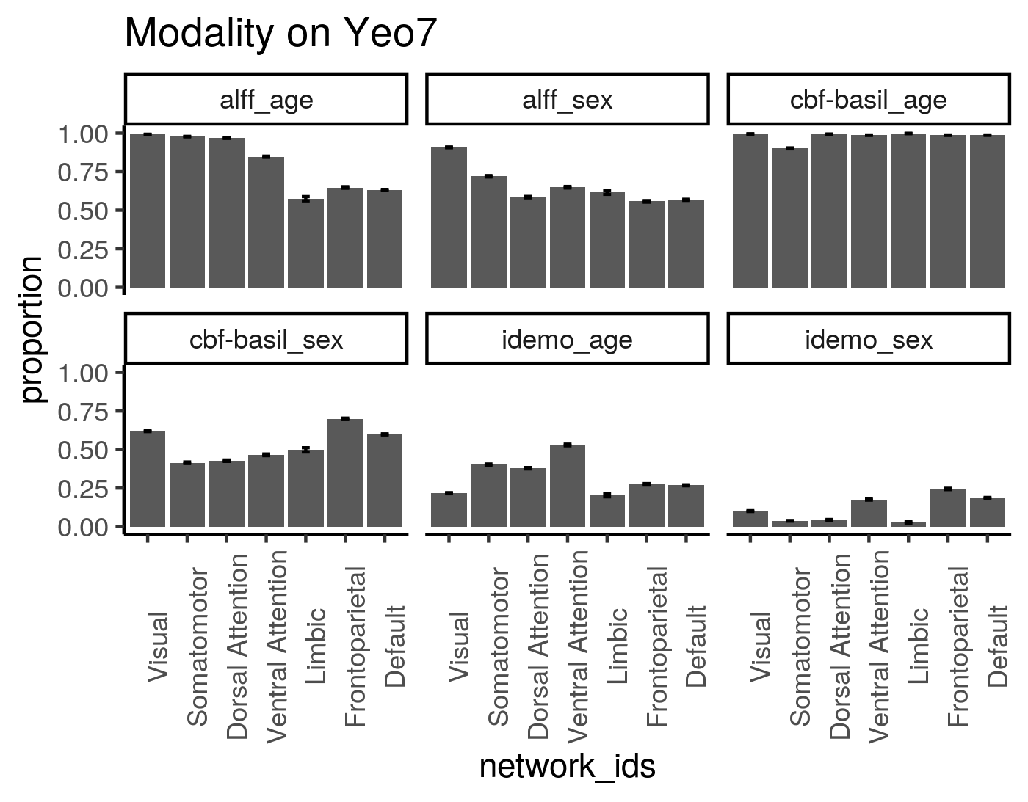

Slide 6
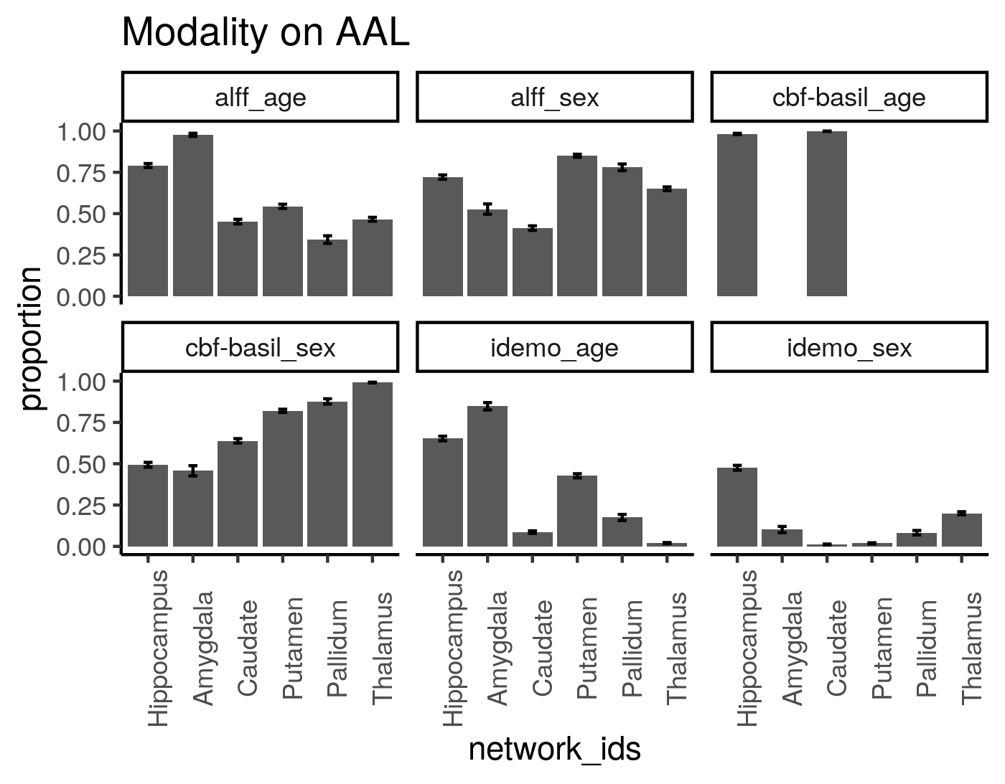

Slide 7
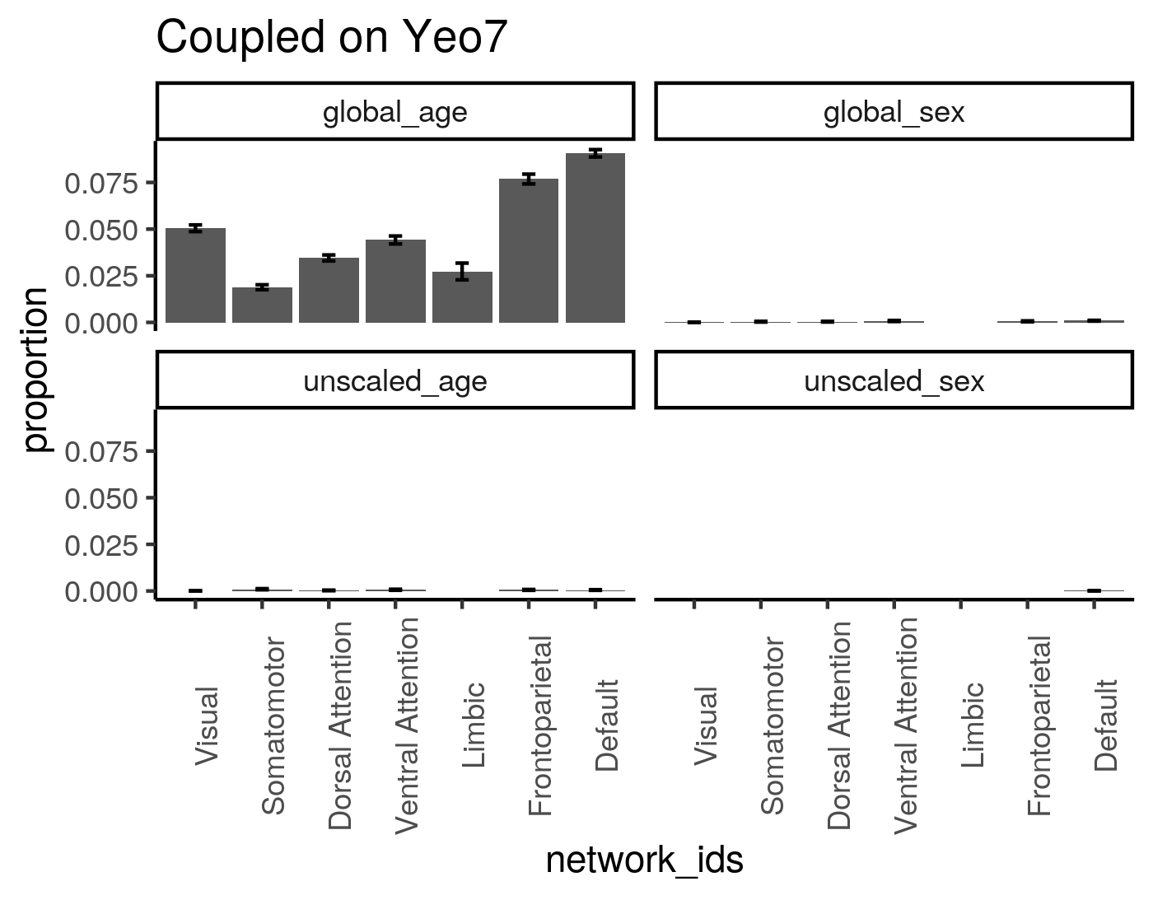

Slide 8
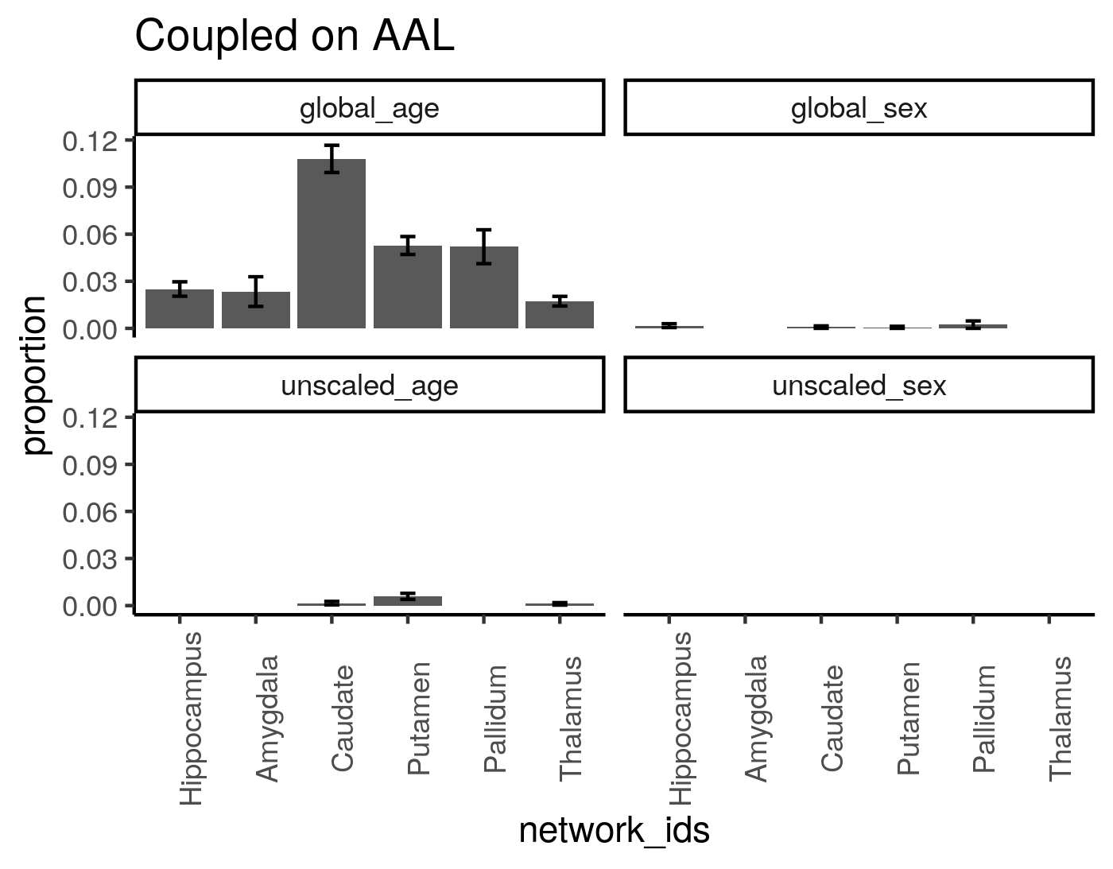

Slide 9
Descriptive Images

Slide 10
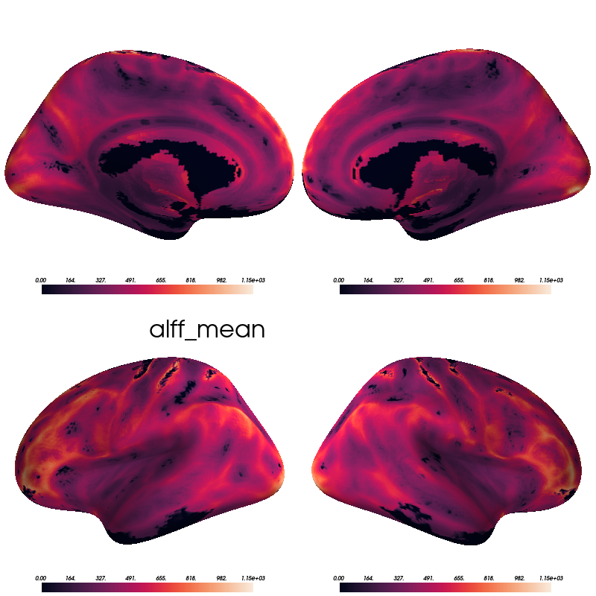

Slide 11
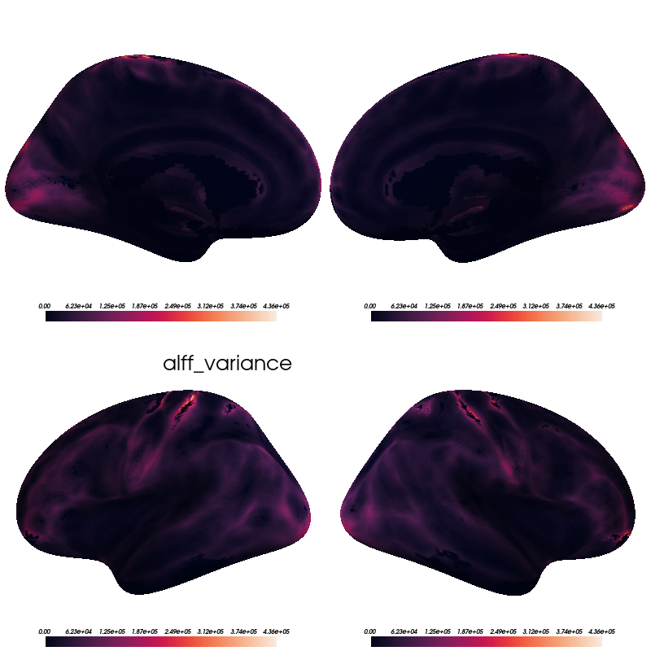

Slide 12
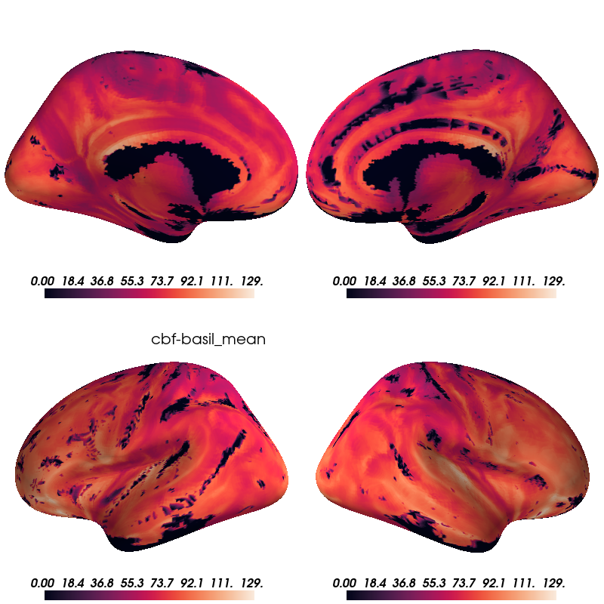

Slide 13
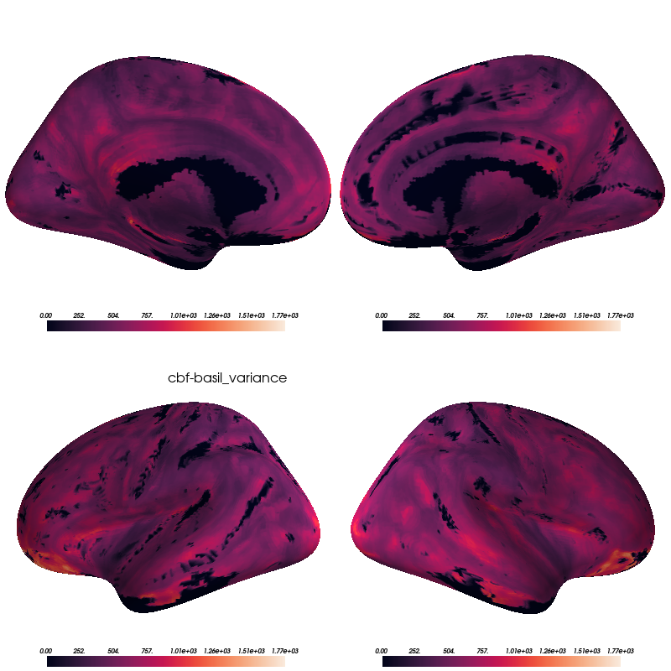

Slide 14
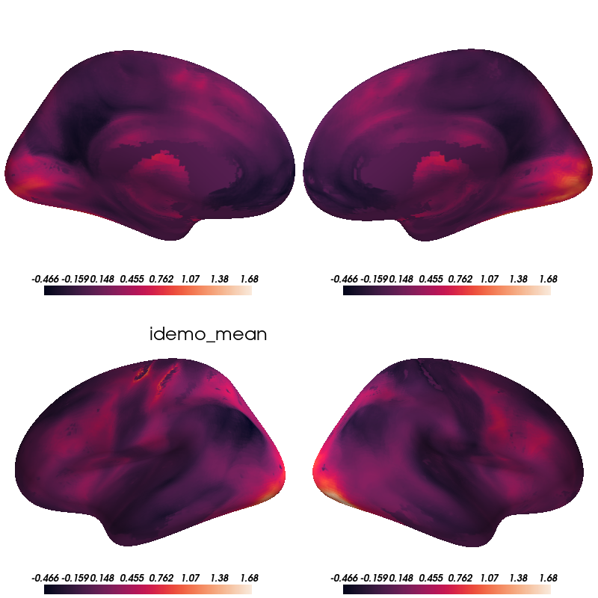

Slide 15
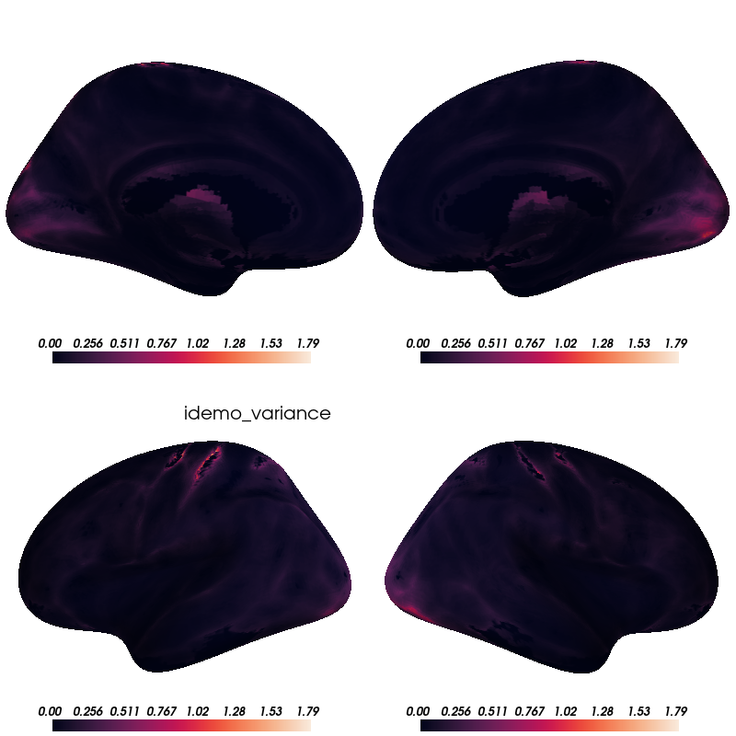

Slide 16
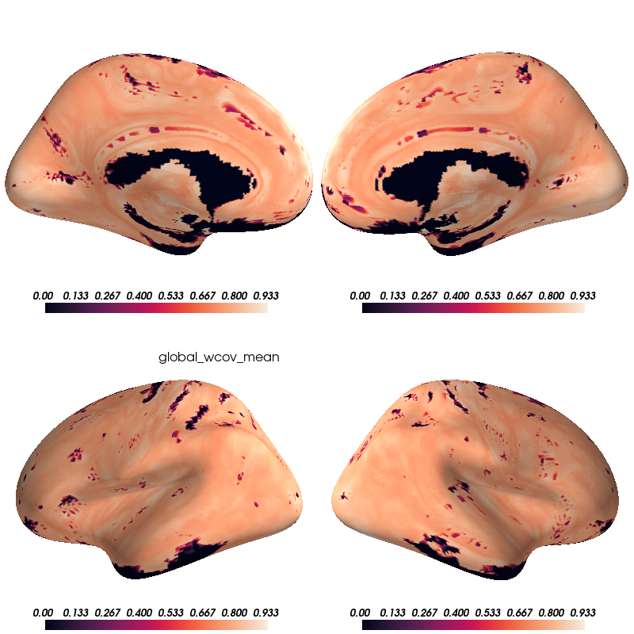

Slide 17
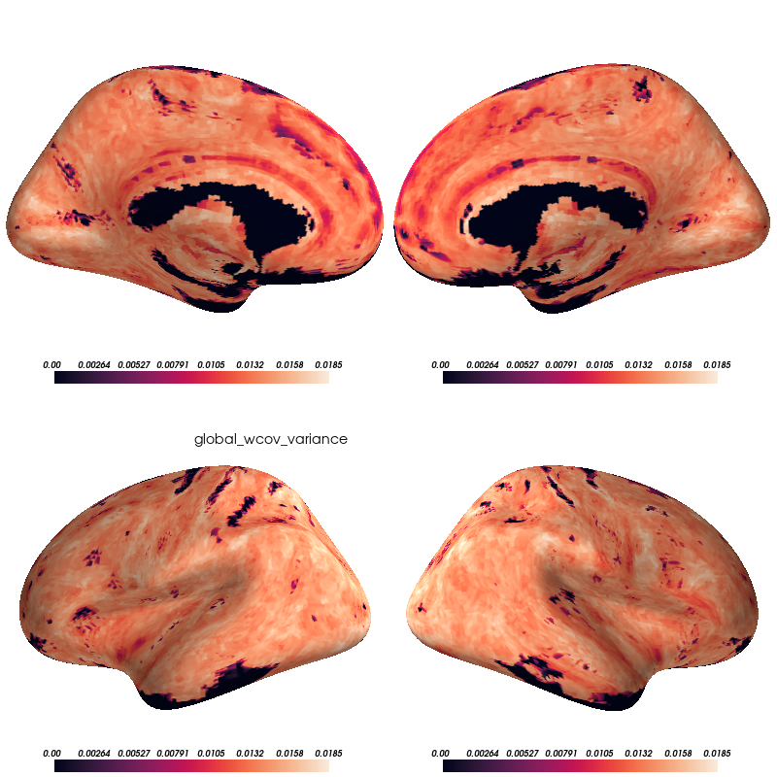

Slide 18
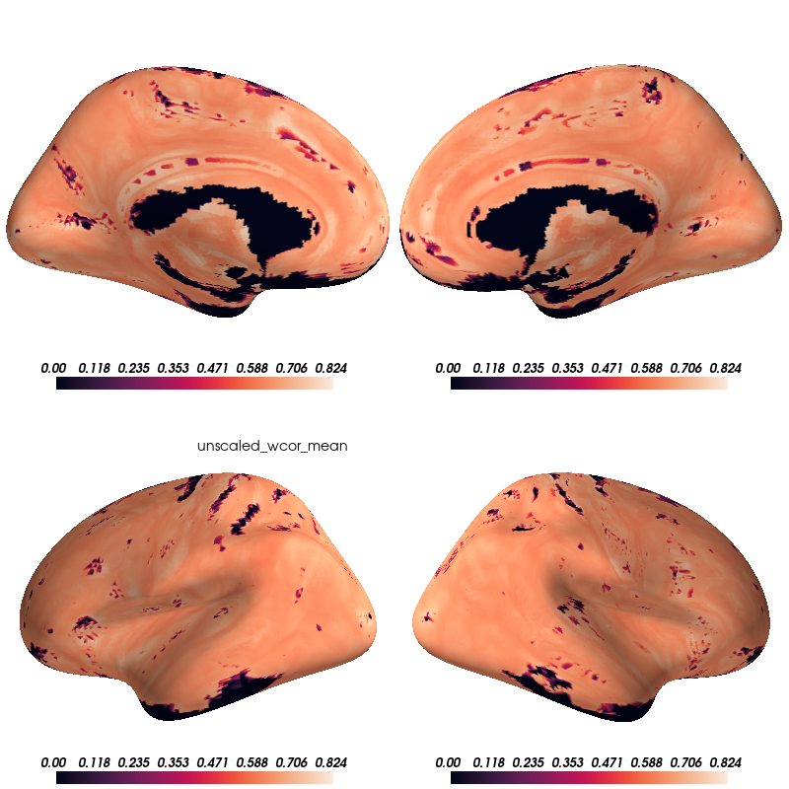

Slide 19
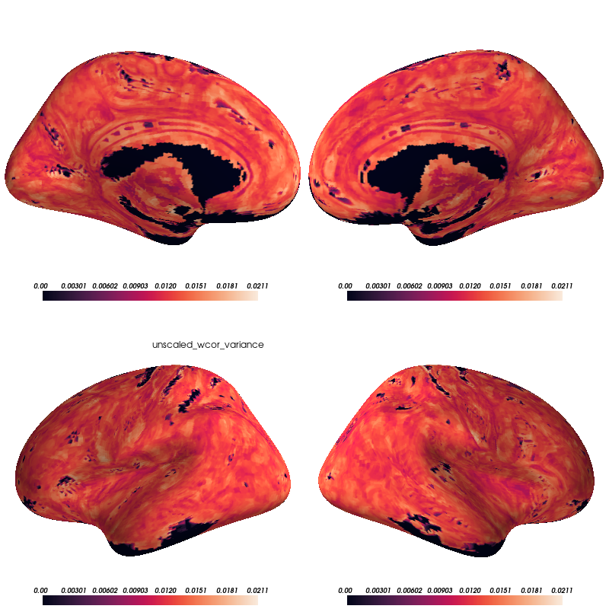

Slide 20
Thresholded P-value Maps (FDR 0.05)

Slide 21
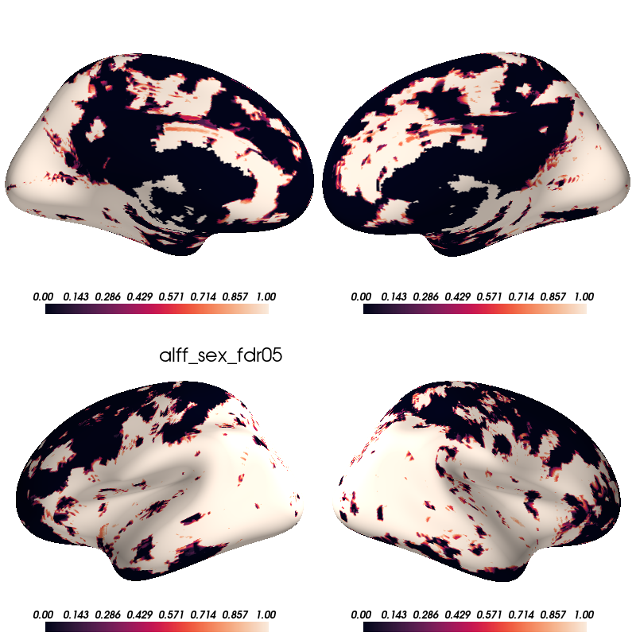

Slide 22
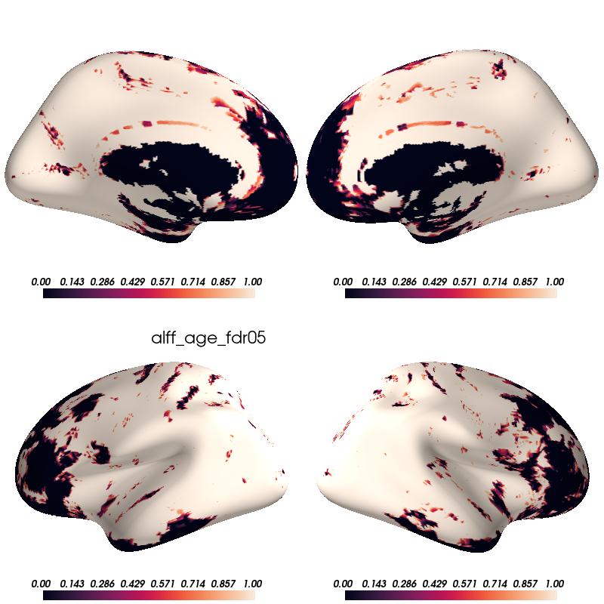

Slide 23
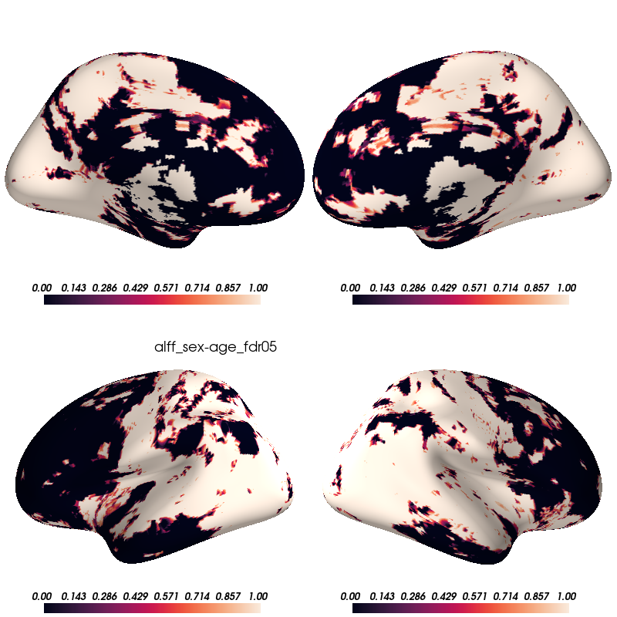

Slide 24
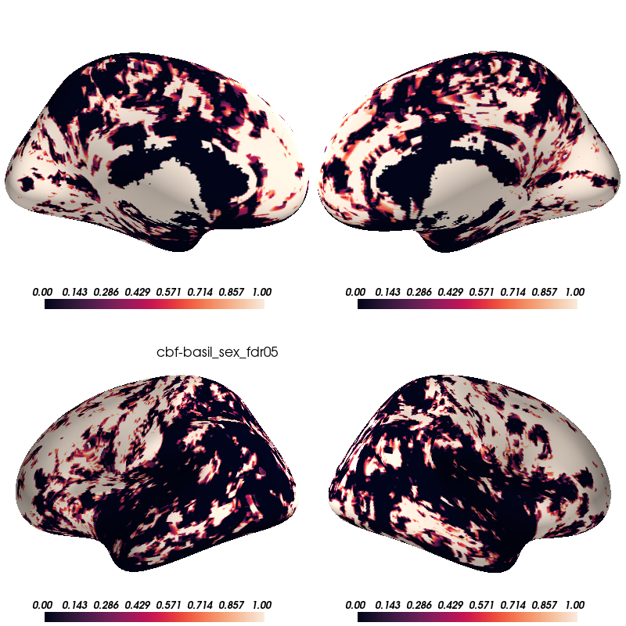

Slide 25
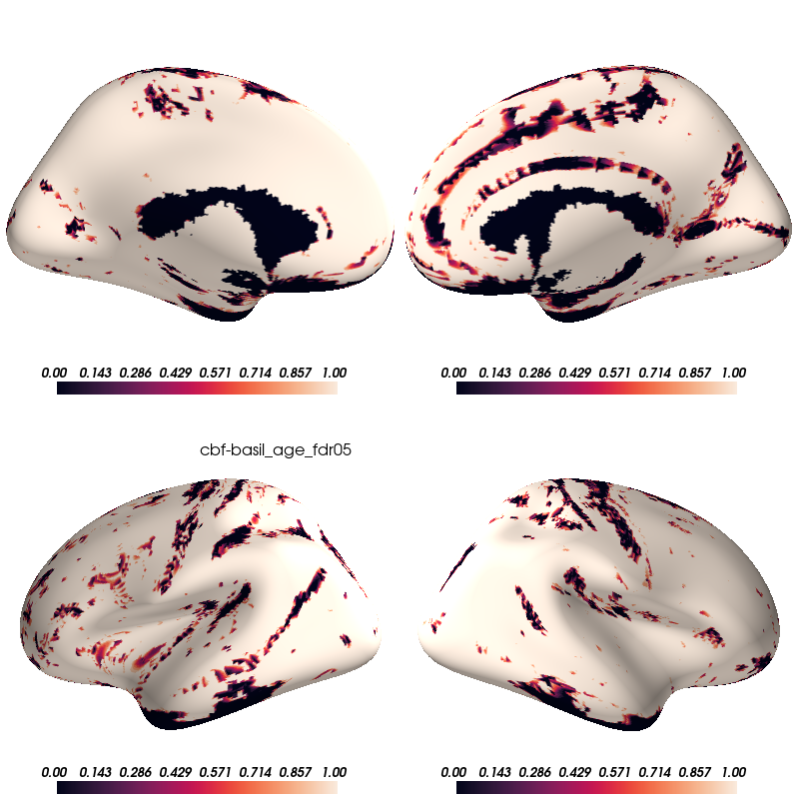

Slide 26
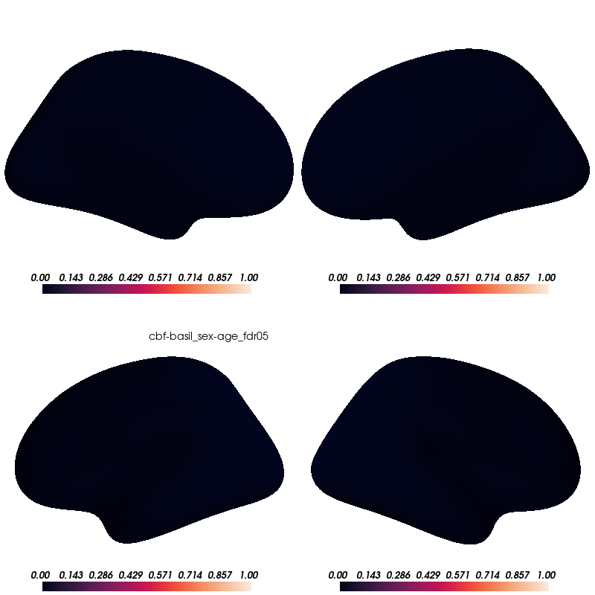

Slide 27
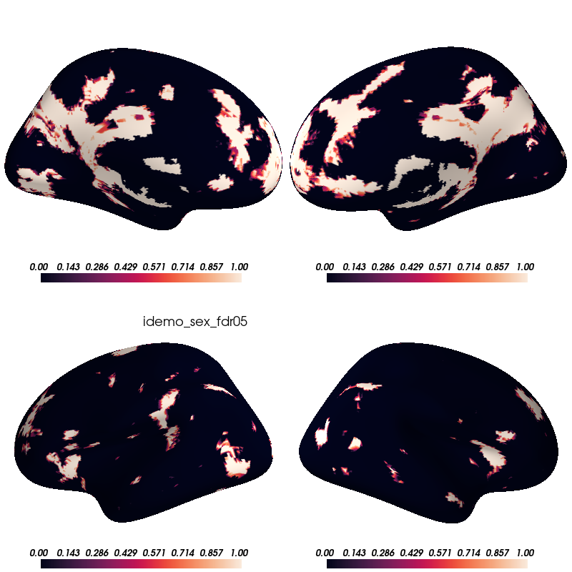

Slide 28
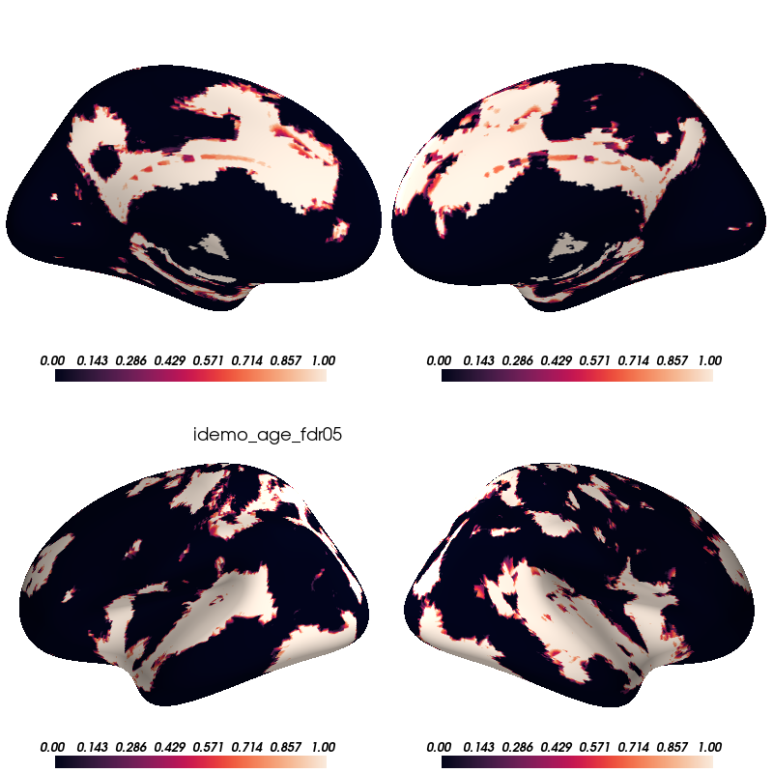

Slide 29


Slide 30


Slide 31
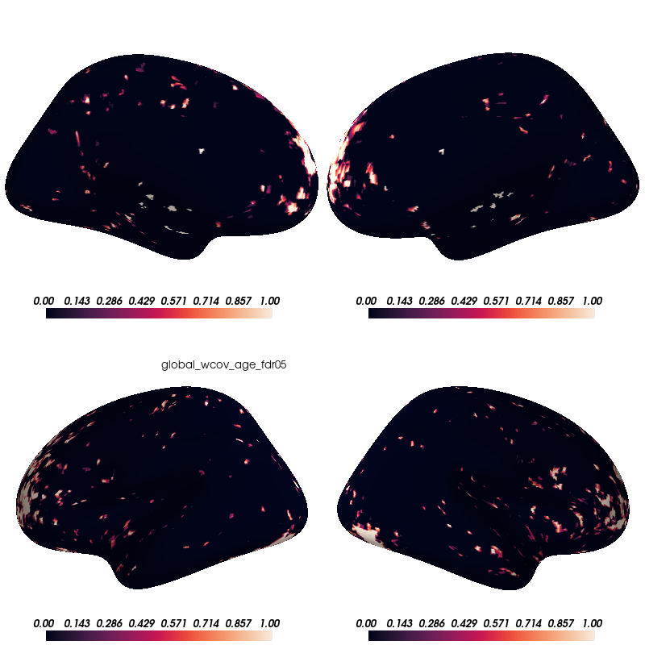

Slide 32
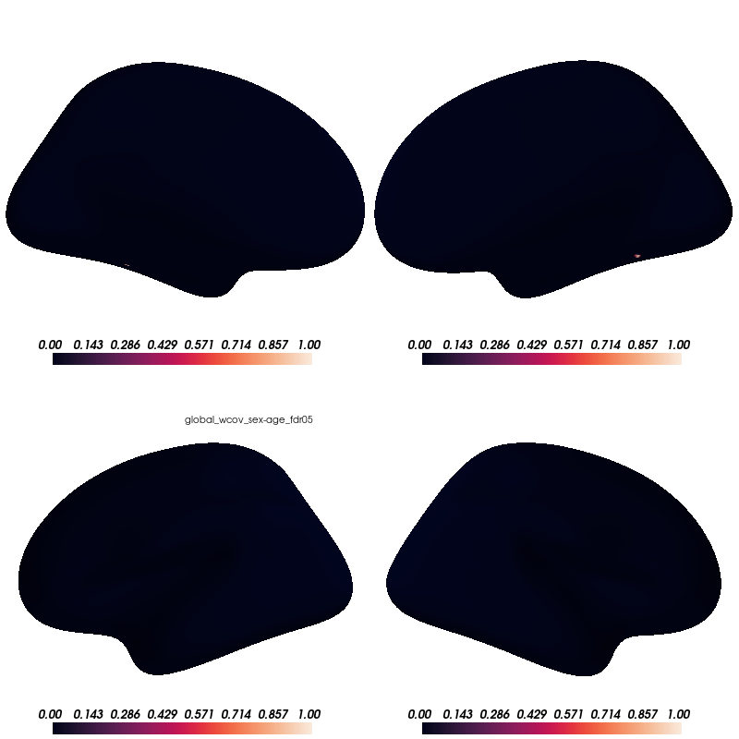

Slide 33


Slide 34


Slide 35


